Slide 1

SUPERMARKET BILLING SYSTEM
ADVANCED OBJECT-ORIENTED PROGRAMMING(AOOP)
BY
SAYYED SAMEER BASIR (2110030317)
N.JAHNAVI (2110020287)
PRANAV KUMAR G (2110030281)
MEHAK GOYAL (2110030313)
Under the guidance of
(FIGLU MOHANTY)

Slide 2
INTRODUCTION
Supermarket billing system is the system to automate the process of ordering and billing a supermarket store. The supermarket is the place where customers come to purchase their daily using products and pay for them. So there is a need to calculate how many products are sold and to generate the bill for the customer.
This system is built for fast data processing and bill generation for supermarket customers. It also allows the customer to purchase and pay for the items purchased. The users will consume less time in calculation and the sales activity will be completed within a fraction of seconds whereas a manual system will make the user write it down which is a long procedure and it also consumes a lot of time.
Because of this software, paperwork will be reduced and the user can spend more time monitoring the supermarket. The project will be user-friendly and easy to use. This project is helpful to computerize the bill report and generate the item’s details. The billing data is a vast collection of product names, prices, and other product-specific data. A product when billed is searched and its price is added to the bill based upon the product quantity.
The system also contains discounts on various products so that the product is offered at discounted price while billing. The supermarket billing system is built to help supermarkets calculate and display bills and serve the customer in a faster and more efficient manner. This software project consists of an effective and easy GUI to help the employees with easy bill calculation and provide efficient customer service.
With the continuous development and improvement of computer technology, communication technology, network technology, and scale database technology, the commercial supermarket has become a developing technology worldwide.

Slide 3
WORKING
Work in the Supermarket will be done in the following way:
The product will come in the store.
The Administrator will enter the information of the product in the database and the price and discount available for each product.
The customer will come and take the basket with him/her and choose the product and take it to the counter.
The bill calculating operator will enter the product number then it will show its information and price and the bill will be calculated and the total payment will be shown.
Customers will pay for the products in online or offline mode.
All the products will be packed and delivered to the customer.

Slide 4
TOOLS REQUIRED
HARDWARE SPECIFICATIONS
Processor: Intel Core i5 Processor
RAM: 8GB(Minimum)
HDD:40GB(Minimum)
SOFTWARE SPECIFICATIONS
Operating System: Windows 11
Front-end: Eclipse
Languages Used: Java

Slide 5
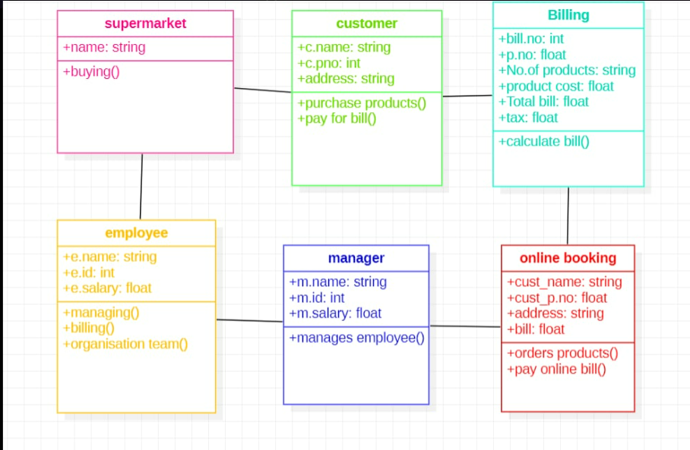
UML /CLASS DIAGRAM
.

Slide 6
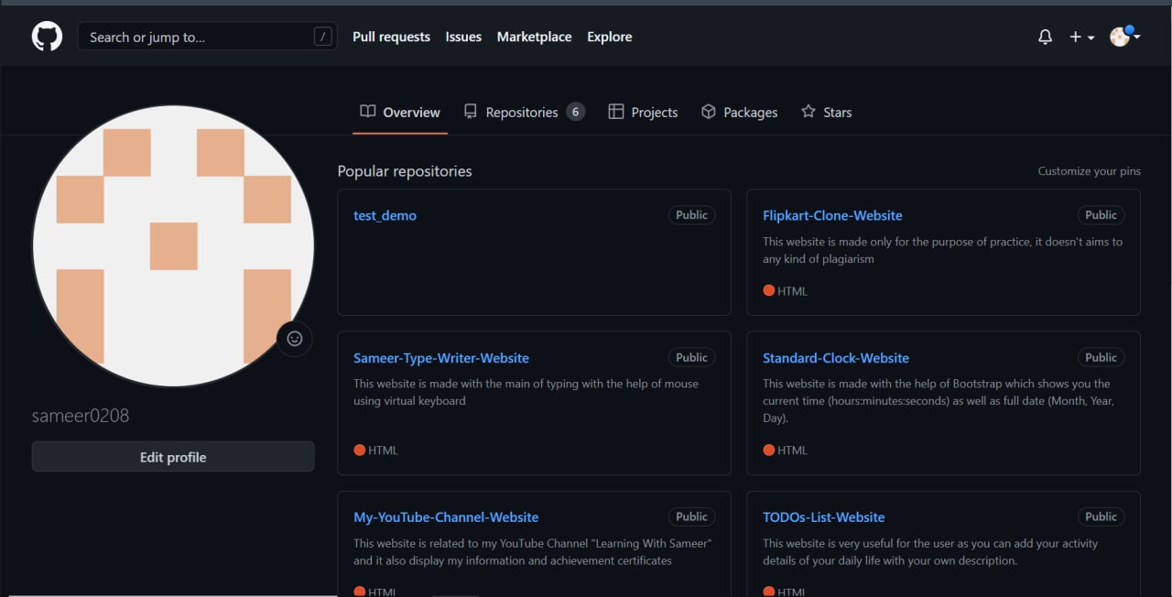
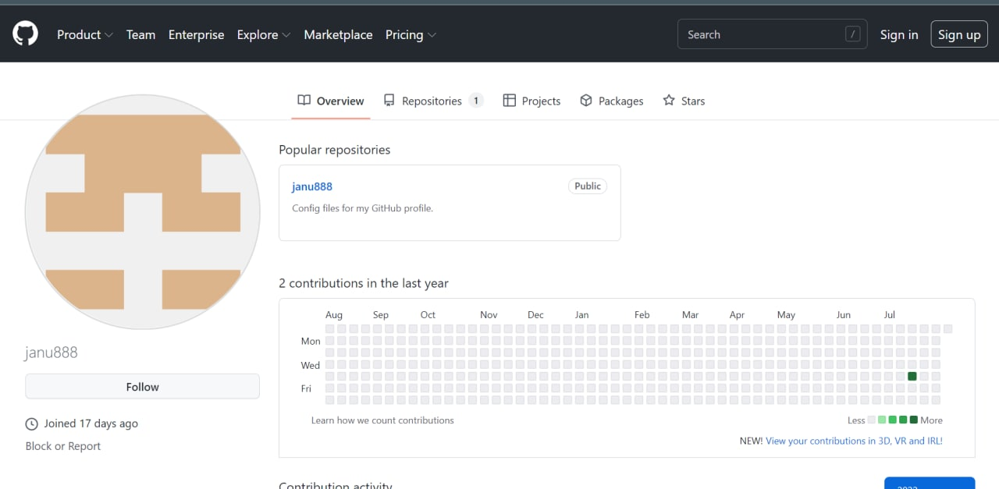
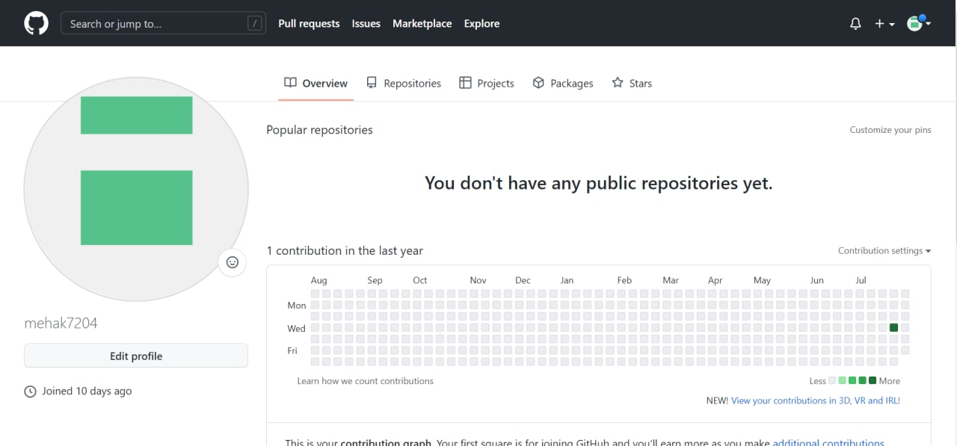
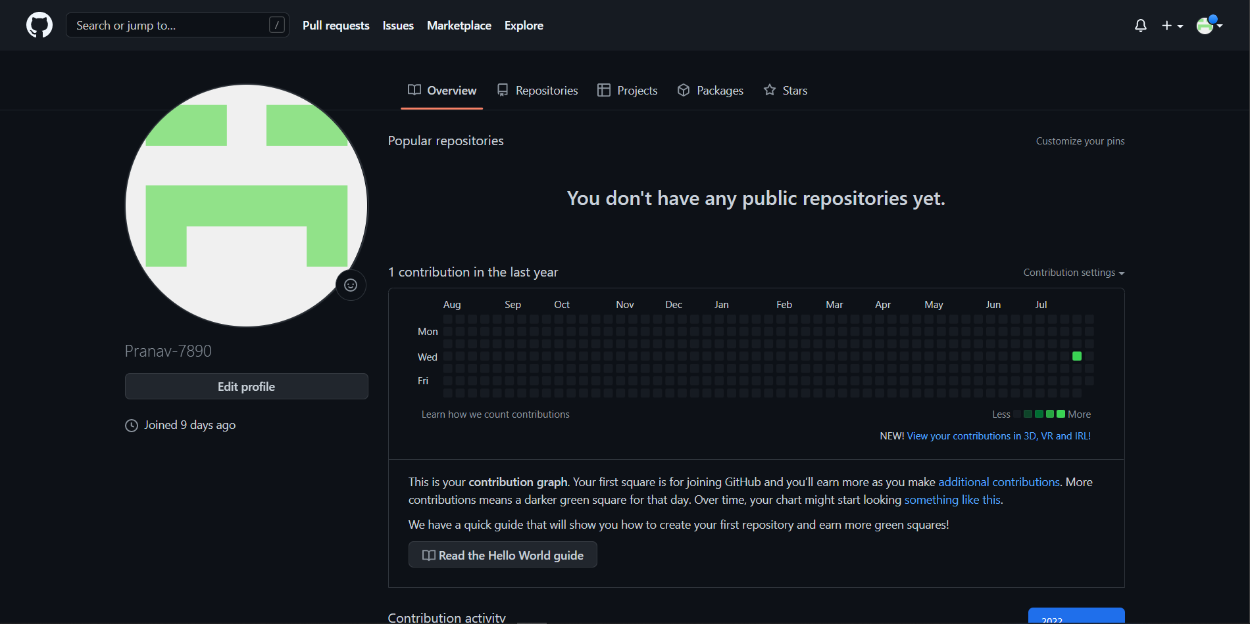
GITHUB SETUP
SAYYED SAMEER BASIR (2110030317)
N.JAHNAVI (2110020287)
MEHAK GOYAL (2110030313)
PRANAV KUMAR G (2110030281)

Slide 7
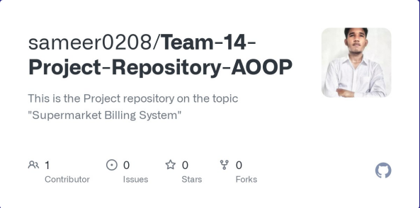
GITHUB GROUP SETUP
https://github.com/sameer0208/Team-14-Project-Repository

Slide 8
CONCLUSION
This software has been developed and designed to reduce the time taken to handle the sales activity. It is designed to replace an existing manual record system for reducing the time taken for calculations and for storing data.
This system has been developed with oops concepts. The system is strong to handle daily operations where the database is cleared over a certain time. This system will reduce manual work, and calculations and will also provide periodic reports at any time.

Slide 9

THANK YOU ☺

